Slide 1
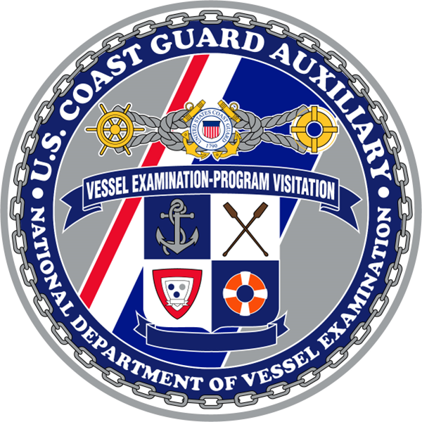
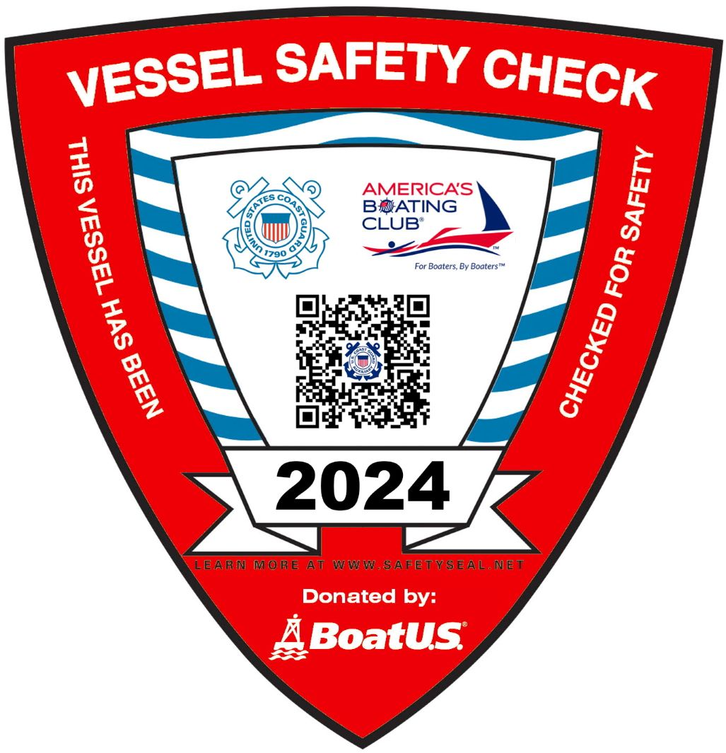
2024 VESSEL EXAMINER WORKSHOP for both USCG Auxiliary and US Power Squadrons
Prepared by the
UNITED STATES COAST GUARD AUXILIARY DIRECTORATE FOR VESSEL EXAMINATION
AND PARTNER VISITATION
Notes:
Welcome to the 2024 Vessel Examiner Workshop for both the USCG Auxiliary & US Power Squadrons (America’s Boating Club)
Includes topics VEs requested to be included and information based on questions received.
Can be done either in a group facilitated by an experienced VE or individually.
USCG Auxiliary be sure to complete the “Self-attestation” form and SUBMIT/ENTER into ADII
(NEXT SLIDE)

Slide 2
Workshop requirements
All Vessel Examiners must complete the 2024 “Vessel Examiner Workshop”.
US Power Squadrons/America’s Boating Club Vessel Examiners must complete the 2024 “Vessel Examiner Workshop” and “Appendix A”.
US Coast Guard Auxiliary Vessel Examiners must complete the 2024 “Vessel Examiner Workshop” and “Appendix B”.
2024 “Vessel Examiner Workshop” to be completed by June 30, 2024.
Notes:
VEs not completing the “Vessel Examiner Workshop” by June 30, 2024 will no longer be qualified to do VSCs, until workshop is completed & recorded.
All VEs must complete the “Vessel Examiner Workshop”.
USCG Auxiliary VEs must also complete “Appendix B” while USPS Ves should complete Appendix A”.
USCG Auxiliary be sure to complete the “workshop self-attestation” form and SUBMIT via FSO-IS to be RECORDED into AUXDATA II prior to June 30, 2024.
(NEXT SLIDE)

Slide 3
Welcome to the 2024 VE Workshop
This workshop contains the following topics:
General Guidance for VEs
“A VSC is not about the boat”
“I Want a VSC” QR
VSC vs UPV
MMSI, EPIRB, PLB
Fire Extinguisher - date marking
Paddlecraft VSC
7012 updates
Electrical Systems - recommended
Appendix A (USPS/America’s Boating Club only)
Appendix B (USCG Auxiliary only)
Notes:
Here are the topics that will be covered in this year’s workshop.
(NEXT SLIDE)

Slide 4
General Guidance for VEs
Vessel Examiners must always take safety into account when conducting a Vessel Safety Check:
Consider both your own capabilities as well as external factors like weather in your safety calculation.
VEs should NOT enter confined spaces during the VSC.
You may ask the owner to take a photo of the item you are evaluating.
Be aware of state and local regulations and educate the owner on them.
Only items on the VSC form (a7012/7012a) shall be evaluated for the VSC.
Notes:
Vessel Examiners (VE) should evaluate the risk to themselves and the boater when conducting a Vessel Safety Check
(NEXT SLIDE)

Slide 5
“A VSC is not about the boat”
Ground rules that everyone holding a VE certification needs to remember:
Rule 1: The boat is only the means for educating the boater. As are the safety regulations, boats are increasingly complex, so operators need to be better informed.
Rule 2: As a VE you can be successful even if no VSC is performed. It might sound counterintuitive, but you have done your job if you engage a boater and educated them about the most elementary issue.
Rule 3: To engage a boater, start by looking to give them something. It could be advice or information, or it could be something tangible.
Rule 4: Remember that we are not law enforcement, so don’t act like it. To be engaging , we cannot be standoffish.
Allow the VSC to become a teachable moment.
Do not rush through VSCs to get the numbers.
Notes:
Vessel Examiners (VE) serve two roles, EDUCATOR and EXAMINER.
Remember the VE’s motto: Prevention through Interaction.
Raise boaters’ awareness of safety issues through one-on-one contact with volunteer Vessel Examiners.
Do not rush VSCs. Spend the time to interact in the education process. Sometime it’s the VE learning.
* From an article by Richard Young, DVC-BD, in the “RBS Job One” Vol 9 Issue 1.
(NEXT SLIDE)

Slide 6
New Decal - I Want a VSC QR code
2024 VSC decals include a QR code that:
Provides direct access to the “I Want a VSC” website.
Drives boaters to request new or renewal VSC.
Notes:
Accessing “I Want a VSC” online has a new method.
Major changes are:
Beginning is 2024 the VSC decal will include a QR code.
The QR provides direct access to the “I Want a VSC” website.
Easy method for sharing the “I Want A VSC” website to get new VSC requests.
Easy method for boat owner to request a renewal VSC.
(NEXT SLIDE)

Slide 7
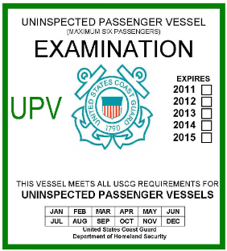
VSC or UPV?
Vessel Safety Checks (VSC) are for Recreational Vessels less than 65 feet long. Vessel Examiners must NOT conduct a VSC on a Commercial Vessel or a vessel for hire.
Uninspected Passenger Vessels (UPV) are a commercial vessel that have different regulations than recreational pleasure vessels.
Visual clues a vessel is an UPV:
Signs offering charter, guide service, fishing charter, or bed & breakfast.
Excessive amounts of fishing equipment.
Questions a VE can ask a boater:
Do you ever require contributions from your passengers?
Do you ever have people use your boat as a B&B?
UPVs can be a sailboat, motorboat, or PWC.
An UPV safety examination cannot be given by a Vessel Examiner.
UPV Decal
Notes:
٠ It is important that a Vessel Examiner consider whether the boat they are about to examine could be an “Uninspected Passenger Vessel” (UPV) . Since a UPV and a recreational boat can look the same, the VE needs to be alert to signs and ask questions to ensure the vessel is indeed ONLY used as a recreational vessel. UPVs can be used as a recreational vessel, but still can’t be issued a VSC decal.
A UPV is a commercial vessel or vessel for hire that must meet stricter requirements than a recreational vessel.
UPVs are less than 100 GT and limited to 6 passengers or less, or 100-300 GT carrying 12 passengers or less. The operator must have a valid Merchant Mariner Credential.
UPVs can’t be inspected by a VE or have a VSC decal issued.
Be alert to vessels that may have the following conditions that means they’re an UPV:
Passenger(s) required to contribute to fuel, food, or beverages.
Passenger(s) required to pay/donate to be aboard.
Charter boats with a paid captain/operator.
A boat used as a Bed & Breakfast.
Water jet devices that are rented with a representative helping operate it.
UPVs can be any type of vessel (sail, motor, PWC, or paddlecraft).
An illegal UPV is a violation of USCG rules, with potential impact upon safety of life and property. Violators are be subject to significant penalties for each violation.
Sources of additional information about a UPV:
https://www.dco.uscg.mil/Portals/9/DCO%20Documents/5p/5ps/NVIC/1994/NVIC%207-94%20Full%20Version.pdf
https://wow.uscgaux.info/Uploads_wowII/P-DEPT/PaxForHire_trifold.pdf
(NEXT SLIDE)

Slide 8
MMSI – Critical Discussion Topic
DSC distress calls with out-of-date MMSI registrations make a resolution of distress situations much more difficult.
Maritime Mobile Service Identity (MMSI) is used by maritime Digital Selective Calling (DSC) to uniquely identify a ship’s radio station.
It is required to keep the MMSI registration current:
Sell a vessel with radio - Transfer the MMSI registration to the new vessel owner at the time the vessel is sold.
Buy a used radio – Must contact the radio manufacturer to remove the original MMSI. Enter a new MMSI into the radio.
Update their MMSI registration whenever their contact or vessel information changes.
More MMSI info can be found at:
https://www.navcen.uscg.gov/maritime-mobile-service-identity
Notes:
For boaters with a VHF radio, it is imperative that you discuss the DSC/MMSI as part of your education process. The USCG is counting on us to help reduce the amount of missing or incorrect data currently out there.
Educate the vessel owner about their responsibility to accurately maintain their MMSI registration.
Share with vessel owner the different methods of maintaining an accurate MMSI registration:
Selling the vessel. Both the seller and buyer must show proof that both parties concur with the transfer. If not, must remove original MMSI. Enter new MMSI into radio.
Buying a used radio. Replace existing MMSI with new MMSI.
If unable to “transfer” MMSI registration MUST remove, per manufacture’s instructions, original MMSI and enter a new MMSI.
Whenever their contact or vessel information changes must update their MMSI registration thru their MMSI registration agent.
MMSI registration agents: FCC, BoatUS, US Power Squadrons, Sea Tow (no longer issuing new MMSI), and Shine Micro Inc.
MMSI must be obtained from FCC if the recreational vessel does either;
(1) travels to foreign ports
(2) makes international communications.
Use of inaccurate MMSIs is a violation of FCC rules, with potential impact upon safety of life and property. Violators are subject to penalties, including monetary penalties as high as $16,000 for each violation.
(NEXT SLIDE)

Slide 9
EPIRB and PLB – Critical Discussion Topic
Out-of-date (missing) EPIRB or PLB registrations make a resolution of distress situations much more difficult
Emergency Position Indicating Radio Beacon (EPIRB) and Personal Locator Beacon (PLB) are used to transmit a distress call, on the 406MHz frequency, through the international COSPAS-SARSAT system.
It is free to register EPIRB and PLB in the NOAA Beacon Registration Database. https://beaconregistration.noaa.gov/RGDB/index
It is required to keep the EPIRB and PLB registration current with NOAA:
Sell/transfer a EPIRB or PLB - Log in to their registration and change the status of it to “Sold/Transferred.”
Buy a used EPIRB or PLB – Need to register it as though it is new. Double-check the ID and if correct. Then register it and submit.
Update the registration whenever their contact or vessel information changes. NOAA will request a renewal every 2 years.
Notes:
For boaters with a EPIRB and/or PLB, it is imperative that you discuss the EPIRB and PLB as part of your education process. USCG is counting on us to help reduce the amount of missing or invalid data currently out there.
Educate the vessel owner about their responsibility to maintain accurate EPRIB and/or PLB registration.
It is free to register EPIRB and PLB in the NOAA Beacon Registration.
Share with vessel owner the different methods of maintaining accurate EPIRB or PLB registration:
Transfer/Sell an EPIRB or PLB.
Buying a used EPIRB or PLB. The website will alert to the fact the beacon has been registered before, simply ignore the warning.
Whenever their contact or vessel information changes must update their EPIRB or PLB registration thru NOAA.
Use of inaccurate EPRIBs and/or PLBs is a violation of FCC rules, with potential impact upon safety of life and property. Violators are be subject to penalties, including monetary penalties as high as $16,000 for each violation.
(NEXT SLIDE)

Slide 10
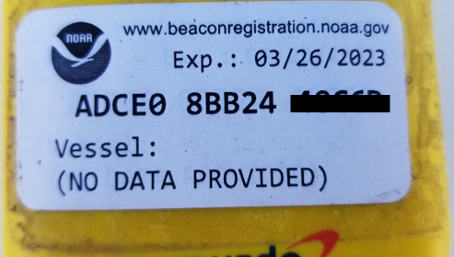
EPIRB and PLB cont’d
EPIRB and PLB must be registered in the country for which they are coded.
EPIRB and PLB registration expire every 2 years.
Registered EPIRB and PLB will have an un-expired “registration decal” affixed, per instructions, on the EPIRB and/or PLB.
More EPIRB and PLB info can be found at:
https://beaconregistration.noaa.gov/RGDB/faq
Craig Brown (USCG Aux & USPS/ABClub)
Registration Decal
Notes:
Educate the vessel owner about their responsibility to register their EPRIB and/or PLB.
EPIRB or PLB must be registered with the national authority associated with the country code in the hex ID of the beacon.
EPIRB and PLB registration expire every 2 years. They’ll receive a reminder email, from NOAA, to renew their registration.
Each registered EPIRB and PLB are to have affixed on them their un-expired “registration decal”.
(NEXT SLIDE)

Slide 11
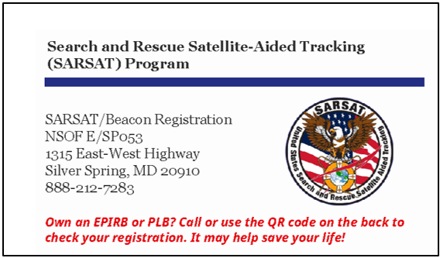
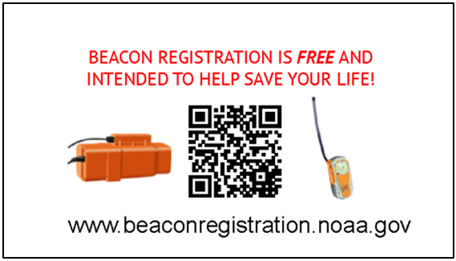
EPIRB and PLB cont’d
Educate Coastal & Great Lakes vessel owners about the advantages of having an EPIRB and/or PLBs.
EPIRB can be easily kept with you, or float off, if abandoning a vessel,
PLB can be kept in a PFD’s pocket to assist locating a MOB (assuming MOB is wearing the PFD),
Where as a MMSI radio doesn’t tend to be easily carried/taken.
VEs should provide the “NOAA SARSAT Beacon Card” to Coastal & Great Lakes vessel owners that plan to or have an EPIRB and/or PLBs.
NOAA SARSAT Beacon Card
Notes:
Educate coastal & Great Lakes vessel owners about the advantages of having an EPIRB and/or PLBs.
EPIRB can be easily kept with you, or float off, if abandoning a vessel.
EPIRBs float.
Can be kept in an easy to grab location or in an abandon ship (ditch) bag.
Some EPIRBs are designed to be kept in a float off location if the vessel sinks. They’ll automatically begin transmitting when in the water.
PLB can be kept in a pocket to assist locating a MOB.
Persons on the vessel’s deck should have a PLB in a pocket (PFD, pants or shirt).
MMSI radios don’t tend to be easily kept with you away from the vessel.
NOAA SARSAT Beacon Card
Should be given to coastal or Great Lake vessel owners.
To be used to encourage current or future EPIRB or PLB owners to register & maintain their contact information.
Very limited supply available. Units can make copies to supplement the supply.
(NEXT SLIDE)

Slide 12
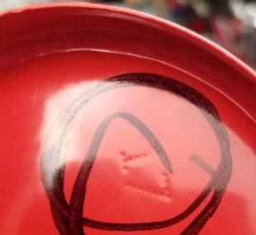
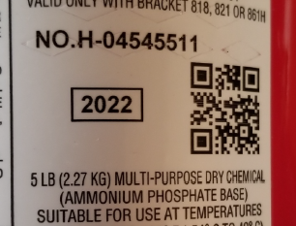
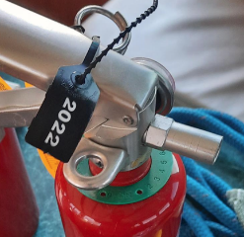
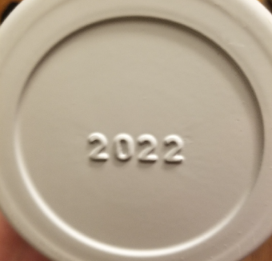
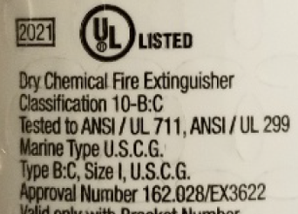
Fire extinguisher – Date markings
“date [year] of manufacture”
Craig Brown (USCG Aux & USPS/ABClub)
Craig Brown (USCG Aux & USPS/ABClub)
Amerex
(only make rechargeable)
Sentry
(only make rechargeable)
David McBride (USPS/ABClub)
“verification-of-service” collar
If the fire extinguisher doesn’t have a “date [year] of manufacture” then it is older than 12 years.
Meaning it has expired, unless it has an unexpired “verification-of-service” collar.
Kidde (and West Marine)
(make both non-rechargeable & rechargeable)
Craig Brown (USCG Aux & USPS/ABClub)
First Alert
(only make rechargeable)
Notes:
“Rechargeable” and “Non-Rechargeable” fire extinguishers without a “date [year] of manufacture” are EXPIRED.
A previous flier incorrectly stated fire extinguishers without a “date [year] of manufacture” were still valid (counted).
If extinguisher has a unexpired “Verification-of-Service” collar (month & year) then it’s still serviceable (counts/passes).
Extinguishers “expire” on December 31 twelve (12) years after “date [year] of manufacture”.
After “expired” does NOT count towards required number of extinguishers. Can still be on the vessel.
VEs shall:
Check the fire extinguisher has an unexpired “date [year] of manufacture” or “Verification-of-Service” collar.
Check the “Rechargeable” fire extinguisher has a current “annual” maintenance [inspection] tag.
Check the fire extinguisher meets all serviceable requirements.
(NEXT SLIDE)

Slide 13
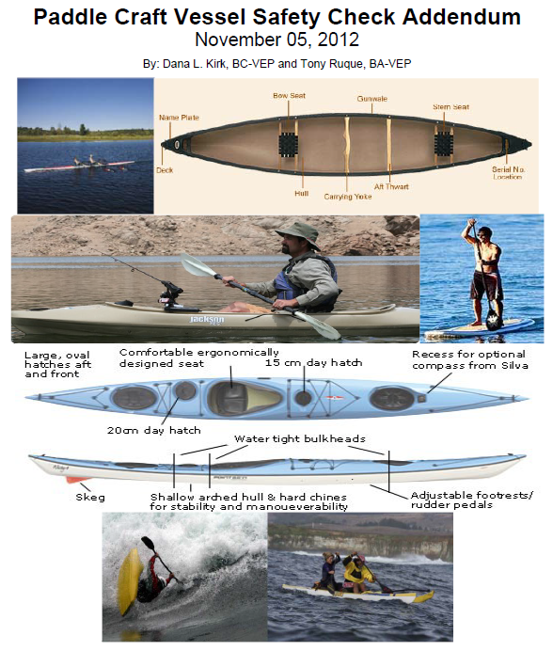
Paddlecraft: Vessels Subject to Federal and State Law
40 percent of recreational boaters are Paddlecraft operators
Kayaks
Stand Up Paddleboards (SUPs)
Canoes
Relatively few have any boater education or skills training
Paddlers are subject to Nav Rules and other boating laws
Education is key to their safety and safety of others
Information about how to do Paddlecraft VSCs is available at:
Paddlecraft Vessel Safety Check Addendum:
http://vdept.cgaux.org/JobAidFiles/SUBsVSCManualAddendum.pdf
How to do Paddlecraft VSC video:
https://www.youtube.com/watch?v=cDNCh0LcuhY&list=PLf0cgsHU0rWlOz2DTFLqNJyy86Z2mUJ4T&index=7
Addendum
Notes:
Usage of Paddlecraft is growing fast. It is an inexpensive entry method, but commonly done without proper knowledge.
VEs should be knowledgeable about doing paddlecraft VSCs.
We should be making every effort to increase our outreach to the paddlecraft community through VSCs.
(NEXT SLIDE)

Slide 14
ANSC 7012
7012 “Vessel Safety Check” form “coming” updates:
Addition of MMSI/EPIRB/PLB “must discuss” for those with VHF radios.
Moving “manufacturer” requirements to the Discussion section
Items 15a, 15b, 15c and 15d are more appropriately classified as “recommendations” rather than legal requirements under current CFR interpretation
Updated form pending approval.
Definitions of “Requirements” are found on the back of the 7012 form.
The 7012 form is frequently updated.
Use the latest PDF of the 7012 form found at:
https://forms.cgaux.org/forms1.php
Notes:
٠ 7012 “Vessel Safety Check” form is being updated:
Each of these items are more appropriately classified as recommendations, there is no legal requirement for the boat operator in regard to these items. There are some manufacturer requirements, but current interpretation from BSX is that we cannot hold the operator responsible for these items.
15 a. – Deck free of Hazards/Clean Bilge
15 b. – Electrical Systems
15 c. – Fuel Systems
15 d. – Galley/Heating Systems
Adding MMSI/EPIRB/PLB as a “must discuss” item.
(NEXT SLIDE)

Slide 15
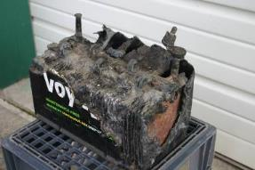
Electrical Systems - Recommended
Does battery safety apply to boats with outboard engines?
Yes, battery safety apply to boats with outboard engines unless the battery “is part of an outboard engine.” “Part of” means the battery(s) is directly built-in or attached to the equipment.
Does battery safety apply to battery(s) for other than engine(s) or motor(s) systems?
Yes, battery safety apply unless the battery is “part of portable equipment.”
According to insurance statistics from BoatUS, 55% of fires on boats are of an electrical origin, with half of those coming from short circuits in DC circuits.
Craig Brown (USCG Aux & USPS/ABClub)
Notes:
Electrical systems are part of the manufacturers requirements, so while it is “recommended” that batteries be tied down and positive terminals covered, the VE cannot require the owner to do this.
Does battery safety apply to boats with outboard engines?
Yes, battery safety apply to boats with outboard engines unless the battery “is part of an outboard engine.”
“Part of” means the battery(s) is directly built-in or attached to the equipment.
Does battery safety apply to battery(s) for other than engine(s) or motor(s) systems?
Yes, battery safety apply unless the battery is “part of portable equipment.”
An Incorrect quotation of the CFR has been passed around. The entire CFR must be taken into account.
(NEXT SLIDE)

Slide 16
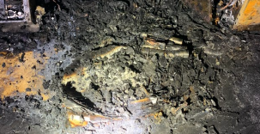
Electrical Systems - Recommended
Lithium-Ion batteries are commonly found on boats.
cell phone, computer, camera, handheld radio, power battery, etc.
Discuss Lithium-Ion battery safety with the boat owner/operator.
Avoid unsupervised charging.
Use proper chargers to avoid overcharging.
Ensure batteries and devices using them are certified by Underwriters Laboratory (UL).
Keep batteries and chargers away from heat sources and flammable materials.
Follow manufacturers’ instructions for the care and maintenance.
Properly dispose of damaged batteries.
NTSB Report MIR-23-23
Remains of a Lithium-Ion battery charger
Notes:
Lithium-Ion batteries are becoming very common aboard vessels.
cell phone, computer, camera, handheld radio, power battery & etc.
Share Lithium-Ion battery safety with the boat owner/operator.
Avoid unsupervised charging.
Use proper chargers to avoid overcharging.
Ensure batteries and devices using them are certified by Underwriters Laboratory (UL).
Keep batteries and chargers away from heat sources and flammable materials.
Follow manufacturers’ instructions for the care and maintenance.
Properly dispose of damaged batteries.
Lithium-Ion batteries do NOT like water. Protect them from exposure to water.
(NEXT SLIDE)

Slide 17
Appendix requirements
US Power Squadrons/America’s Boating Club
Vessel Examiners must complete the “Appendix A”.
US Coast Guard Auxiliary
Vessel Examiners must complete the “Appendix B”.
Notes:
USPS VEs must complete “Appendix A” along with the “Vessel Examiner Workshop”.
USCG Auxiliary VEs must complete “Appendix B” along with the “Vessel Examiner Workshop”.
(NEXT SLIDE)

Slide 18
Appendix A
US Power Squadrons/America’s Boating Club
Notes:
USPS VEs must complete “Appendix A” along with the “Vessel Examiner Workshop”.
USCG Auxiliary VEs must complete “Appendix B” along with the “Vessel Examiner Workshop”.
(NEXT SLIDE)

Slide 19
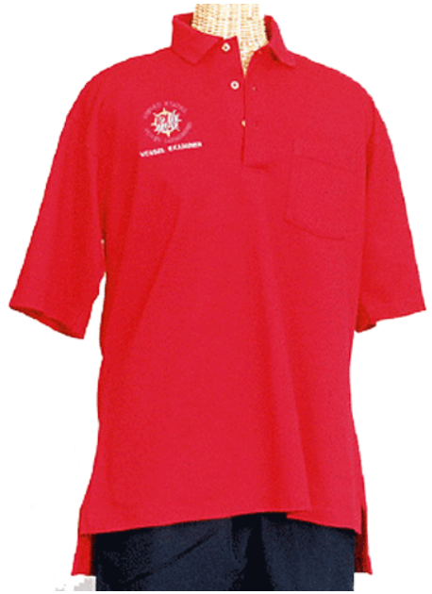
Approved Vessel Examiner Uniforms USPS/America’s Boating Club
Wear the red USPS or America’s Boating Club VE Polo shirt (with words “Vessel Examiner” under the logo)
Wear tan or khaki-colored pants (long or short)
VEs should strongly consider wearing an inflatable life jacket during a Vessel Safety Check.
Must wear a life jacket for all VSCs done on a boat that is on the water.
Never say no to giving a VSC no matter what!
Notes:
To model the behavior we want from our fellow boaters:
VEs should strongly consider wearing an inflatable life jacket to encourage boaters to wear inflatables PFDs.
VEs shall wear a life jacket when the VSC is taking place on/around the water, and are encouraged to do so when doing VSCs a shore.
Forward any questions and comments that you have up the chain of leadership.
VE’s should always find a way to say YES to giving a VSC (vessels 65 feet and under)
(NEXT SLIDE)

Slide 20
Additional Resources
Auxiliary National “V” Department website
http://wow.uscgaux.info/content.php?unit=v-dept
US Power Squadrons National Vessel Safety Check website
https://www.usps.org/departments/12000/12900/12900-vessel-safety-check
America’s Boating Channel
https://www.youtube.com/channel/UC1c_rFyt1fGqvdiSauAijAg
Paddlecraft Vessel Safety Check Addendum
http://vdept.cgaux.org/JobAidFiles/SUBsVSCManualAddendum.pdf
B-Directorate Paddlecraft Safety
http://wow.uscgaux.info/content.php?unit=B-DEPT&category=paddlecraft-safety
Paddlecraft videos
https://www.youtube.com/watch?v=5e0WlXgNGDg
Vessel Safety Checks for Rental Agencies (Liveries)
http://vdept.cgaux.org/JobAidFiles/Vessel-Exams-For-Rental-Marina-Facilities.pdf
Notes:
Have handouts available on web sites to give to boat owners/operators.
(NEXT SLIDE)

Slide 21
2024 VSC STAFF USPS/America’s Boating Club
USCGAux Director (DIR-V) | Jim Cortes
USCGAux Deputy Director (DIR-Vd) | Tom Niles
USCGAux Division Chief – Vessel Exams (DVC-VE) | Craig Brown, SN-CN
USPS Rear Commander – Safety Committee | Chip Meany, AP-IN
USPS Staff Commander – VSC | Art Andrea, AP
Notes:
Use the Chain of Leadership for communications.
Squadron VSC Chair, District VSC Chair, Staff Commander VSC & Rear Commander – Safety
Rear Commander subject to change after the USPS National Annual Meeting.
(NEXT SLIDE)

Slide 22
Conclusion USPS/America’s Boating Club
This completes the 2024 VE Workshop.
On behalf of the entire Auxiliary V-Directorate and US Power Squadrons Safety Committee:
Thank you to all the VEs for the outstanding job you are doing!
Your efforts have a positive impact on recreational boating and contribute significantly to reducing boating fatalities and property damage.

Slide 23
Appendix B
US Coast Guard Auxiliary
Notes:
USPS VEs must complete “Appendix A” along with the “Vessel Examiner Workshop”.
USCG Auxiliary VEs must complete “Appendix B” along with the “Vessel Examiner Workshop”.
(NEXT SLIDE)

Slide 24
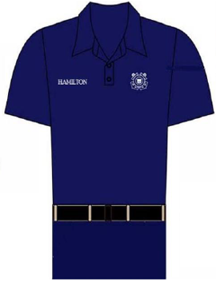
Approved Vessel Examiner Uniforms USCG Auxiliary
Wear one of the following uniforms:
Operational Dress Uniform (ODU)
Alternative Working Uniform (AWU)
or Hot Weather uniform (HWU) (if regionally authorized)
The Auxiliary VE Polo shirt (white, navy blue, or powder blue) is authorized as an optional uniform shirt worn as part of the ODU, AWU, or HWU
Uniforms shall be worn per “BSX Policy Letter 23-02”
VEs should strongly consider wearing an inflatable life jacket during a Vessel Safety Check.
Must wear a life jacket for all VSCs done on a boat that is on the water.
Never say no to giving a VSC no matter what!
AWU
Notes:
To model the behavior we want from our fellow boaters:
VEs should strongly consider wearing an inflatable life jacket to encourage boaters to wear inflatables PFDs.
VEs shall wear a life jacket when the VSC is taking place on/around the water, and are encouraged to do so when doing VSCs a shore.
The VE Polo shirt is not authorized for wear as a stand alone item with civilian clothing or on patrol, and no insignia, name tag, or breast device shall be worn with the shirt.
Must be sourced through the AUXCEN
Headgear (e.g. covers) should ONLY display the member device
VEs shall comply with local policies regarding uniforms.
For specific details on Uniform policies, refer to “BSX Policy Letter 23-02” available at: https://wow.uscgaux.info/content.php?unit=BX-GROUP&category=2023-policy-letters
Forward any questions and comments that you have up the chain of leadership.
VE’s should always find a way to say YES to giving a VSC, (vessels 65 feet and under)
(NEXT SLIDE)

Slide 25
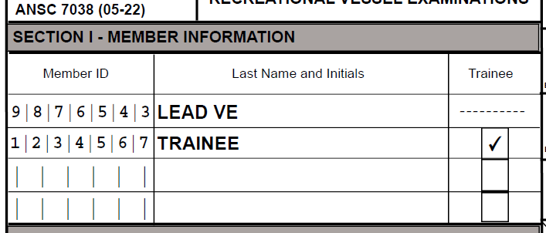
Auxdata USCG Auxiliary
Travel time to & from the VSC is reported as 99B on ANSC 7029 form.
Time spent waiting between VSCs is reported as 99B on ANSC 7029 form.
Mileage & non-reimbursed costs associated with VSCs should be reported on ANSC 7029 form.
If a Facility does NOT pass the inspection, it’s reported under 91A.
Only 1 “lead” per 7038 Form. Do NOT use “Non-Lead”. If working with multiple “trainees”, each trainee must be reported separately.
ONLY 1 “trainee” is listed here.
“Non-lead” are NOT listed.
Notes:
It is important that VEs accurately report their activities in AD2.
Use the ANSC 7029 form to report::
Travel time to & from the VSC is reported under 99B category.
Time spent waiting between VSCs is reported under 99B category.
Mileage & non-reimbursed costs associated with VSCs.
If a Facility does NOT pass the inspection, it’s reported under 91A on the ANSC 7038 form.
List only 1 “lead” per submittal of VSC activity on ANSC Form 7038.
If working with multiple “trainee”, each trainee must be reported on separate ANSC 7038 forms.
(NEXT SLIDE)

Slide 26
Auxdata cont’d USCG Auxiliary
When entering VSC activity into Auxdata
Only the position of “lead” (and “trainee” if required) is used when reporting VSC activity.
The position of “non-lead” is NOT used when reporting VSC activity.
An “assistant” would report their time as 99B on ANSC 7029 form.
For VSC activity
“Non-lead” is NOT used
ONLY 1 “trainee” is listed
ONLY 1 “lead” is listed
Auxdata “Add Member Section”
Notes:
٠ When reporting VSC activity in Auxdata:
Do NOT use “non-lead” for a position.
List only 1 “trainee” per submittal of VSC activity.
List only 1 “lead” per submittal of VSC activity.
An “assistant” reports their time as 99B on ANSC 7029 form.
(NEXT SLIDE)

Slide 27
ANSC 7003
USCG Auxiliary
ANSC 7003 “Offer for Use” form updates (date 10-23):
Personal Floatation Device (PFD) requirements have been combined.
Must have required PFDs. If vessel is capable of speeds over 35 MPH the PFDs must be 50 MPH or higher or PWC rated.
Must have 2 additional PFDs over legal requirement. Speed rating not required.
Must have 2 Safety (ECOS) “Lanyards” if the Facility (boat or PWC) is ECOS equipped.
PFD requirements are combined
current edition
ECOS “safety lanyard” requirement
Notes:
٠ ANSC 7003 “Offer for Use” form has been updated:
Revision 10-23. Previous editions are obsolete.
PFD requirements have been combined into a single check item on the form.
If the vessel is capable of speeds over 35 MPH the PFDs must be 50 MPH or higher or PWC rated.
ECOS “Safety Lanyard” requirements have been added to form.
Any facility with ECOS must have 2 lanyards.
“PWC Offer for Use” form is available at:
https://forms.cgaux.org/archive/a7008_rev_4_protected.pdf
“AUXPAD (paddlecraft) Offer for Use” form is available at:
https://forms.cgaux.org/archive/7009_Rev_2_protected.pdf
(NEXT SLIDE)

Slide 28
Additional Resources
Auxiliary National “V” Department website
http://wow.uscgaux.info/content.php?unit=v-dept
US Power Squadrons National Vessel Safety Check website
https://www.usps.org/departments/12000/12900/12900-vessel-safety-check
America’s Boating Channel
https://www.youtube.com/channel/UC1c_rFyt1fGqvdiSauAijAg
Paddlecraft Vessel Safety Check Addendum
http://vdept.cgaux.org/JobAidFiles/SUBsVSCManualAddendum.pdf
B-Directorate Paddlecraft Safety
http://wow.uscgaux.info/content.php?unit=B-DEPT&category=paddlecraft-safety
Paddlecraft videos
https://www.youtube.com/watch?v=5e0WlXgNGDg
Vessel Safety Checks for Rental Agencies (Liveries)
http://vdept.cgaux.org/JobAidFiles/Vessel-Exams-For-Rental-Marina-Facilities.pdf
Notes:
Have handouts available on web sites to give to boat owners/operators.
(NEXT SLIDE)

Slide 29
2024 V-DIRECTORATE STAFF USCG Auxiliary
Director (DIR-V) | Jim Cortes
Deputy Director (DIR-Vd) | Tom Niles
Division Chief – Vessel Exams (DVC-VE) | Craig Brown
Division Chief – Visitation Programs (DVC-VP) | Aaron Todd
Division Chief – Safety Programs (DVC-VT) | Martin Jordan
Division Chief – Incentive Programs (DVC-VI) | Mark Crary
Division Chief – Special Projects (DVC-VS) | William Jefferson
Division Chief – Communications (DVC-VC) | Zacary Wilson-Fetrow
Notes:
Use the Chain of Leadership for communications.
FSO-VE, SO-VE, DSO-VE, & DVC-VE
(NEXT SLIDE)

Slide 30
Conclusion USCG Auxiliary
This completes the 2024 VE Workshop.
On behalf of the entire Auxiliary V-Directorate:
Thank you to all the VEs for the outstanding job you are doing!
Your efforts have a positive impact on recreational boating and contribute significantly to reducing boating fatalities and property damage.

